Slide 1
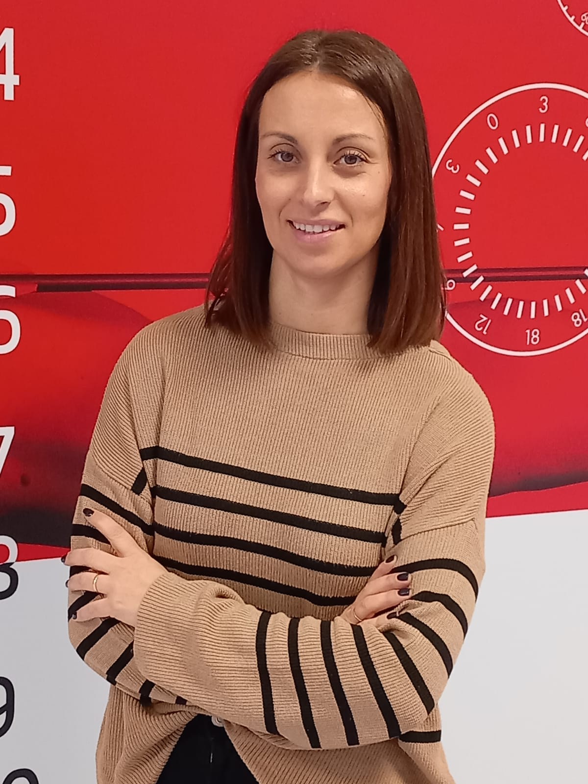
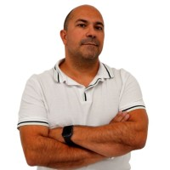
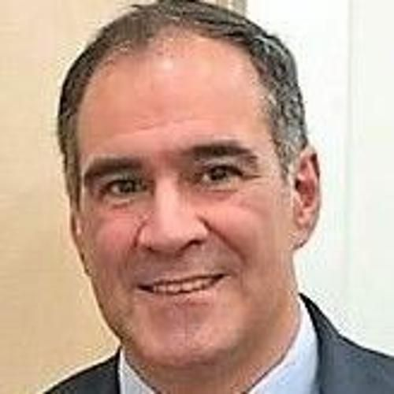
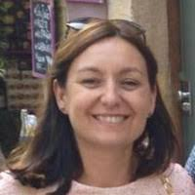
Dean
Dr. Simone Sato
Vice-Dean for Sports Science
Dr. Itziar Pagola
Manager Director EURM
Dr. Marisa Sáenz
Department Director
Sports Science
Dr. Laura Gostian
Vice-Dean for Physiotherapy and Rehabilitation
Dr. José Luis Alonso
Department Director
Sports Science OL and EURM
Dr. Diego Domínguez
Vice-Dean of Medicine Dr. Emilia Condes
Vice-Dean of Nursing
Dr. Ana Giménez
Department Director
Nursing
Dr. Isabel Font
Department Director
Medicine
Dr. Carlos Ramirez
Vice-Dean of Health Sciences
Dr. Lourdes Martín
Department Director
Physiotherapy
Dr. Raquel Diaz-Meco
Department Director
Rehabilitation
Dr. Laura Gonzalez
Simulated Hospital Coordinator
Dr. Oscar Oliva
Director of Research
Dr. David Sanz
Faculty Assistant
Nazareth Escalona
Academic Director
Dr. Cristina Gonzalez

